Slide 1
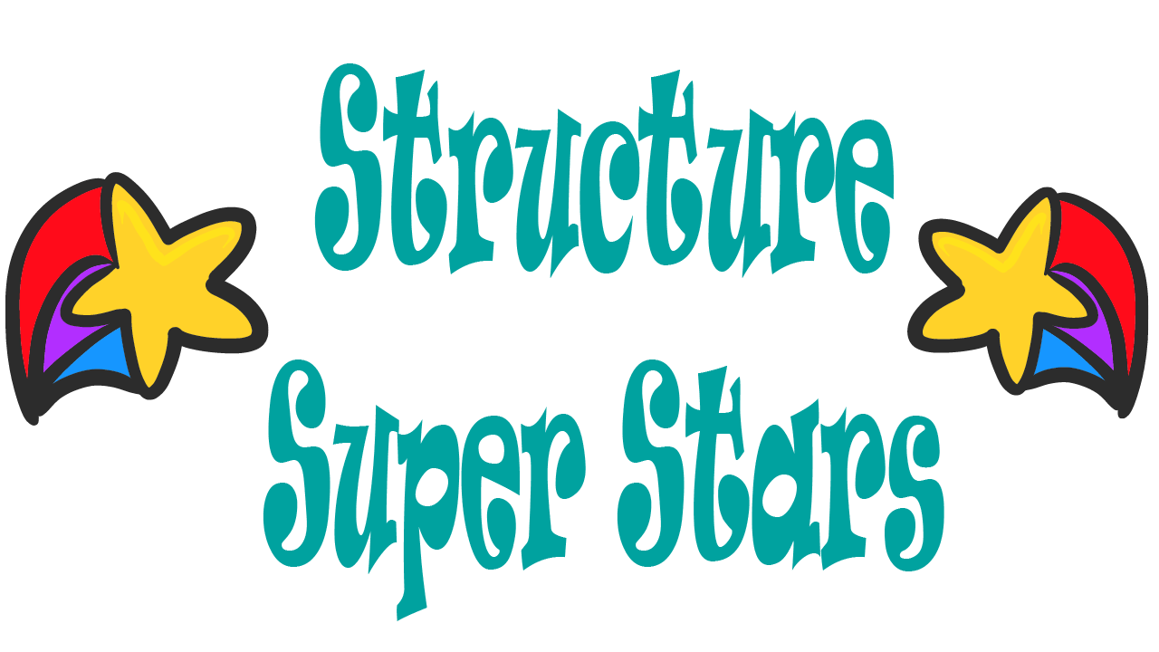
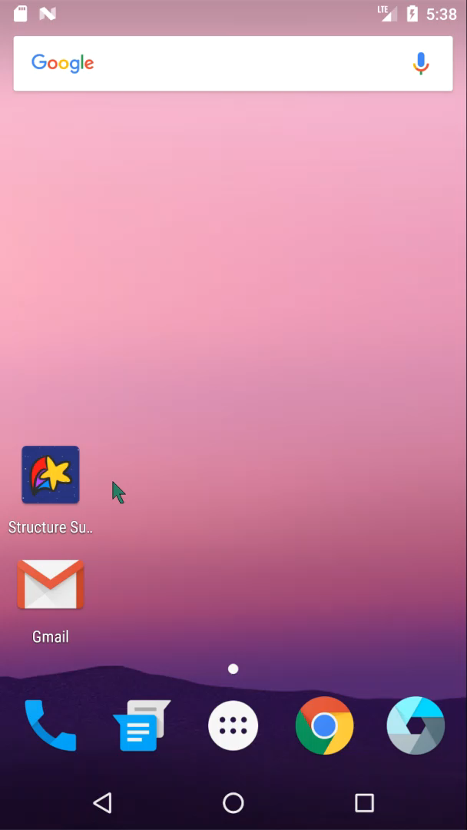

Teaching younger developers about Abstract Data Structures through games
Written By: Gabriela Castillo-Rivera, Vanessa Serao, Micah Jones

Slide 2
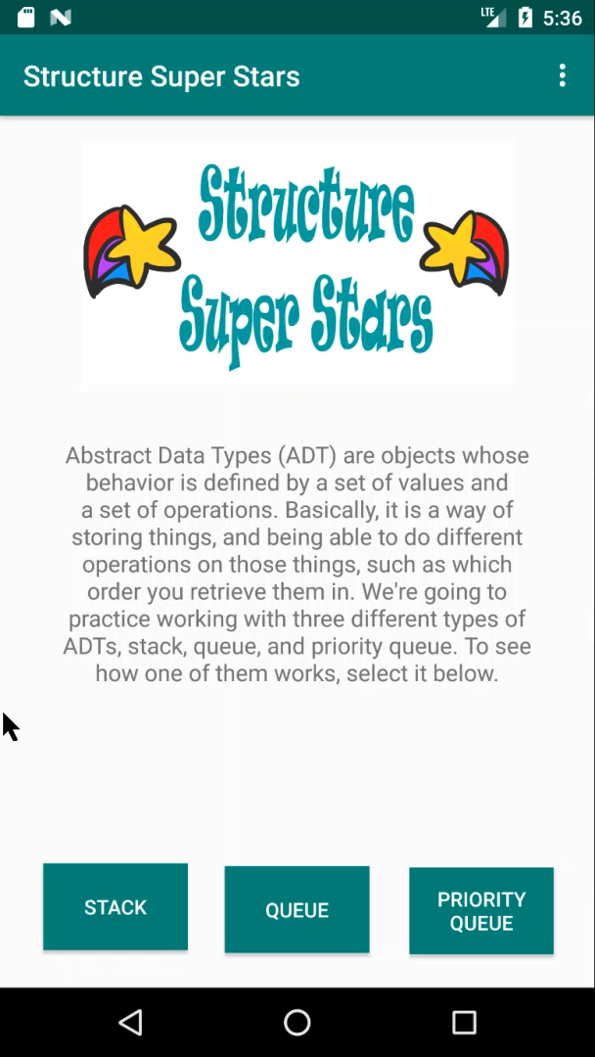

Home Screen – Choose your ADT!
Gives a description of the Abstract Data Types users can learn about
Buttons at the bottom of the screen lead to the game screens for stack, queue, or priority queue

Slide 3
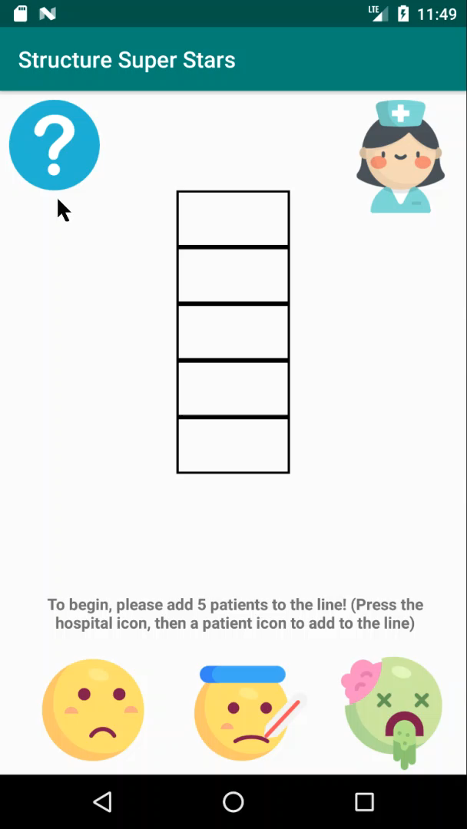

Priority Queue – Take the patient next in line to the nurse!!!
A priority queue can be explained best with the example of a hospital line. First come first serve, but if a patient enters who is in need of more urgent attention, they are served first.
The user can learn about the priority queue by clicking the help button, which shows a pop up window with a description of priority queue, as well as instructions on how to play the game
A short description of the current instruction is shown above the “add patients” buttons

Slide 4
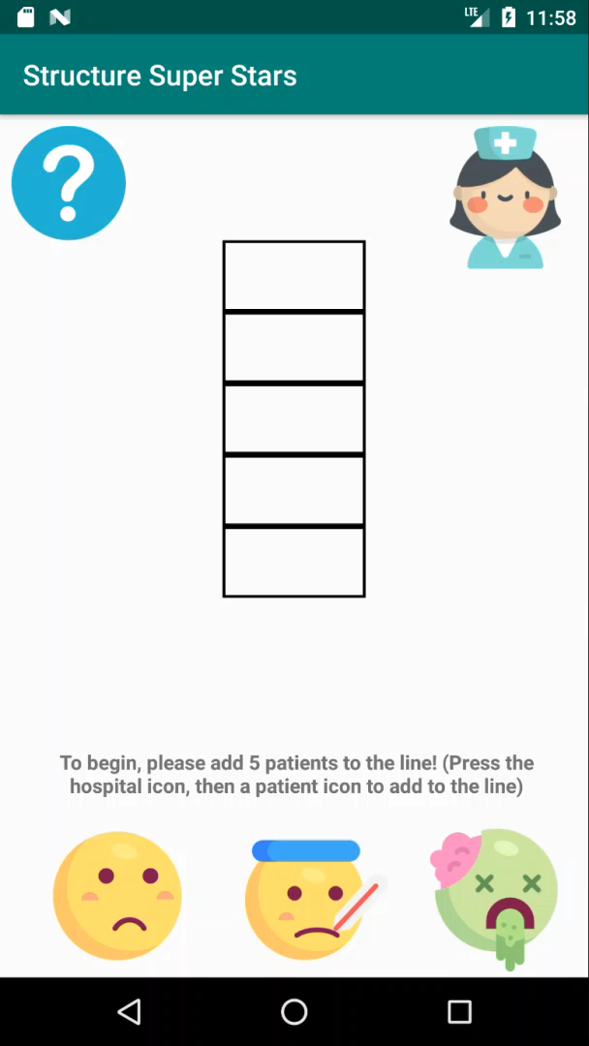

Adding patients to the line
Patients are added to the hospital line by pressing on the buttons representing different priority patients at the bottom and the corresponding enqueue(patient) command is displayed at the top of the line
The priority of each patient is kept in an actual priority queue on the back end to keep track of the hospital line
Once 5 patients have been added, the user is prompted to start the game by dragging the correct patient to the nurse

Slide 5
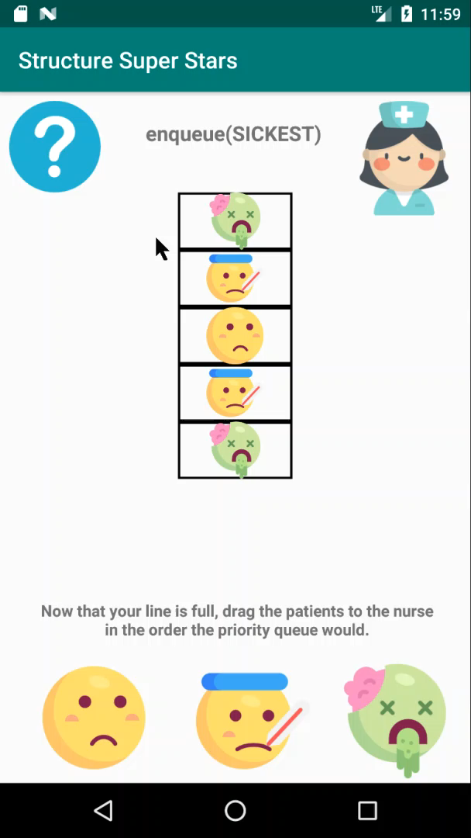

Taking the patient to the nurse
Now the user is encouraged to replicate the actions of a priority queue by dragging the correct patient to the nurse
Two types of errors can be made. If there is a higher priority patient in line, they should go first. If there are two patients with the same priority in line, the patient who got in line first should go first as long as they are the next priority. A toast informs the user of which error occurred if they pick the wrong patient
Just like a line, patients can be added once the game has begun, and the user must adjust what patient is next accordingly
Once the line is empty, the user is congratulated, and can start the game again

Slide 6
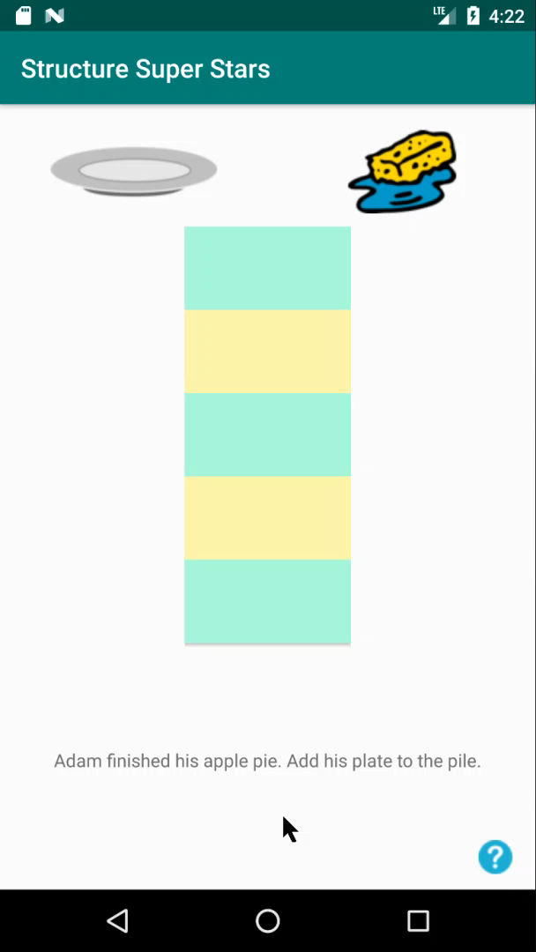
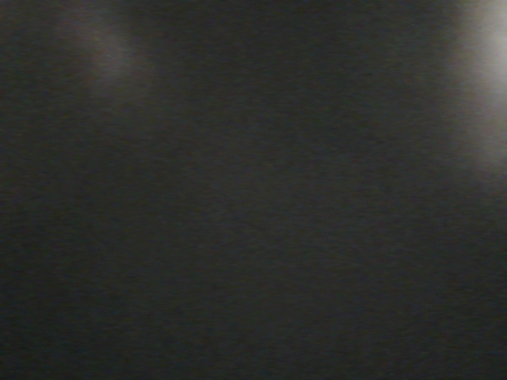
Stack – Help David the Dishwasher wash the dishes!
A stack can be explained best with the example of a dishes being added to a pile and then washed one at a time with the last one added being the first one to be washed.
The user can learn about the stack by clicking the help button, which shows a pop up window with a description of a stack, as well as instructions on how to play the game.
The task the user needs to complete is shown on the bottom of the screen.

Slide 7
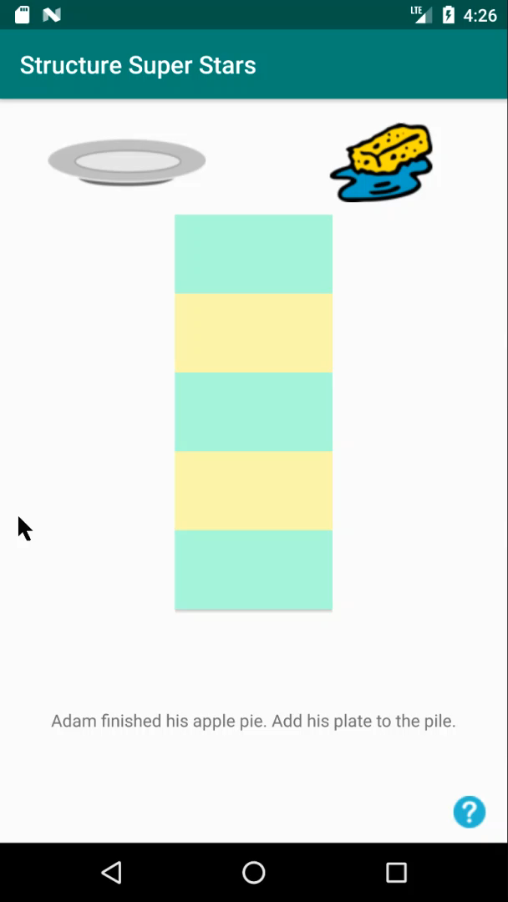

Add dishes to the pile
The first task asks the user to add a dish to the pile. This can be done using the dish button.
If the user tries to pop (wash) a dish, a toast informs the user that popping is not the correct action.

Slide 8
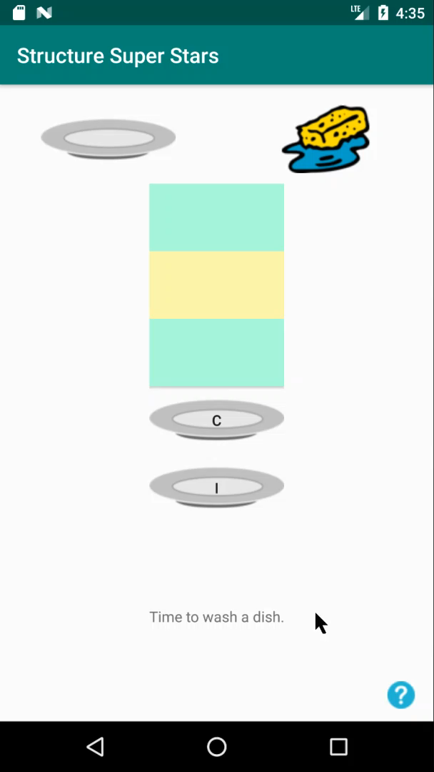

Remove dishes from the pile
Users can remove dishes from the pile by dragging the last dish added from the pile to the sponge button.
If the user tries to push (add) a dish, a toast informs the user that pushing is not the correct action.
If the user tries to pop (wash) a dish that is not at the top of the stack, a toast informs the user that another dish should be washed.
Once the end is reached, the user is congratulated and a message is hidden in the dishes. David the Dishwasher says HI!

Slide 9
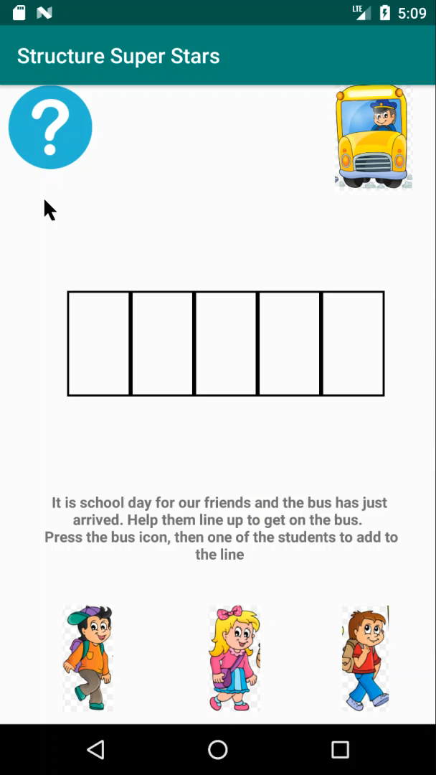

Queue – Take the student to the Bus line !
A queue can be explained best with the example of a bus line. First come first serve, no exception! The first student to enter the line will always be the first one to leave the line.
The user can learn about the queue by clicking the help button, which shows a pop up window with a description of queue, as well as instructions on how to play the game
A short description of the current instruction is shown above the students buttons

Slide 10
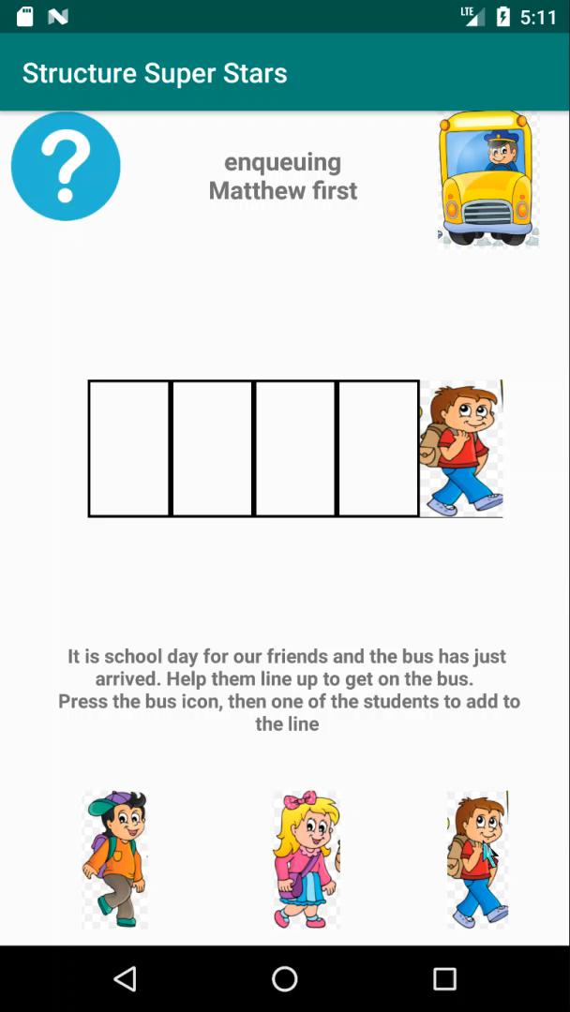

Adding students to the line
The first task asks the user to add the students to the line. This can be done by clicking on any student in the bottom of the screen.
The line must be filled in all the way before the user can load the bus (dequeue).

Slide 11
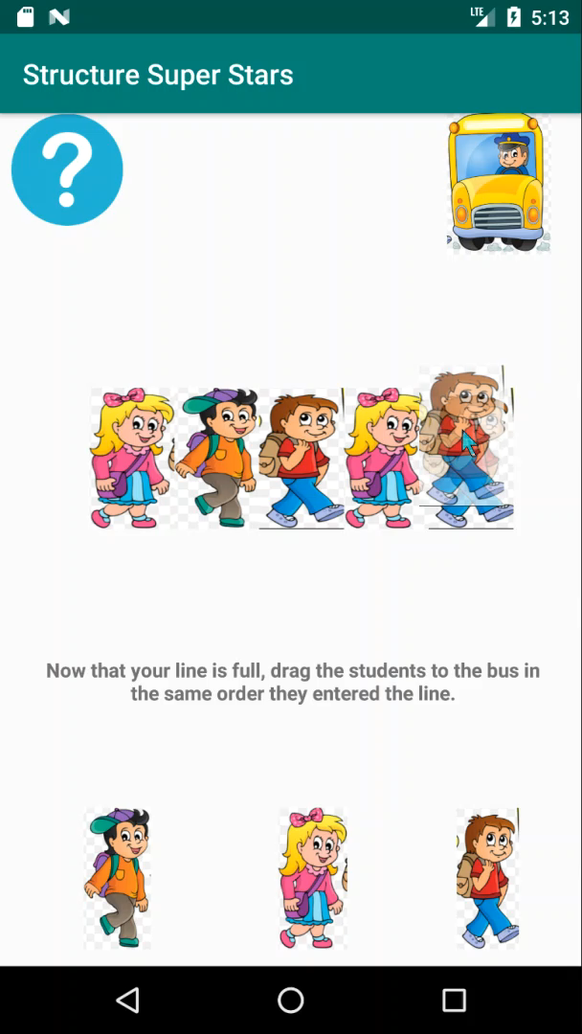

Remove Students from the line
Now the user can load the bus! To do so, the user will drag the first student (front) in line to the bus
If the user drag any student that is not in the front of the list, an error will be shown.
Just like a line, students can be added once the game has begun, and the user must adjust what student is next accordingly
Once the line is empty, the user is congratulated, and can start the game again

Slide 12

Thank you for watching!!!

